Slide 1
Finn Family Moomintroll
By Tove Jansson
Notes:
Begin the book by building background knowledge of the author and the setting for the book.

Slide 2
The goal of our lesson today is to build background knowledge about the book,
Finn Family Moomintroll

Slide 3
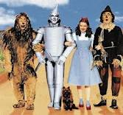
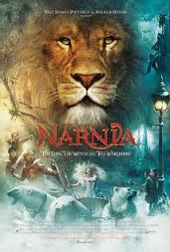
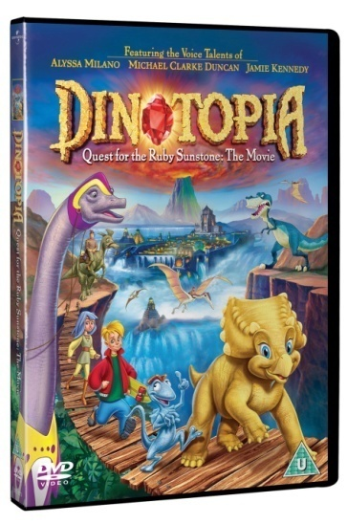
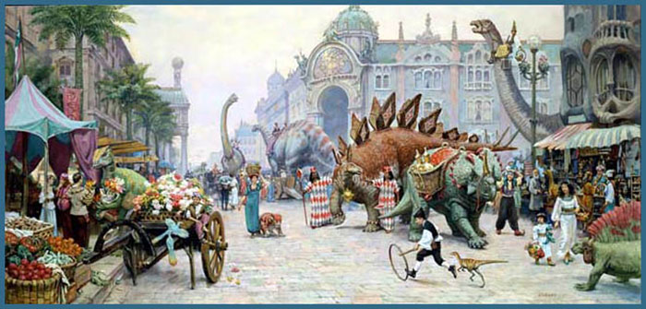
Who are these characters?

Slide 4
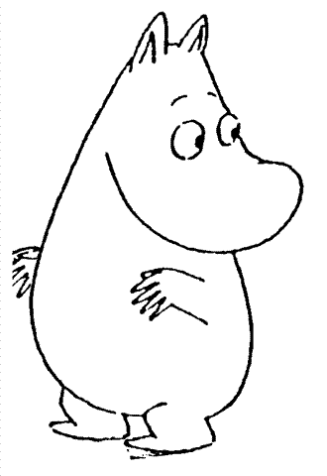
Fantasy World Map

Slide 5
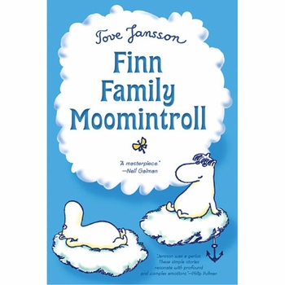
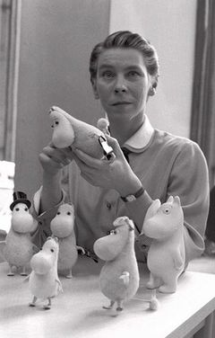
Notes:
Tove Jansson lived in Finland. She wrote the Moomin books in the 1930s.

Slide 6
Notes:
Finland is in Europe. Europe is to the east of the United States and over the Atlantic Ocean. In Finland, the winter time is cold and dark. (show where we live in Arkansas, and compare to where Finland is located.)

Slide 7
Moomin Valley
Notes:
This is the map of Moomin Valley. Point out where Moomin house is. (see inside of the book.)

Slide 8
The Moomins: Mamma, Pappa, Moomintroll, Snorkmaiden

Slide 9
It is Winter
Sniff
Snufkin

Slide 10
Preface
The snow has come!
I know. Your beds are made.
Notes:
The Preface is only three pages. Read the preface, stopping to discuss pine needles (dried leaves)

Slide 11
The moomins have a dinner of pine needles

Slide 12
Winter has come
Notes:
Click on the image to see the video.

Slide 13
Our goal today was to give you background information about the Moomintroll Family.
Do you think you know more about our new fictional family?

Slide 14
Day 2
Our goal today is to retell our story using details from the text.

Slide 15
What do you think this is?
Notes:
This is an actual picture of the Moomintroll House in Finnland. There is an amusement park where they have recreated the entire Moomin Valley.

Slide 16
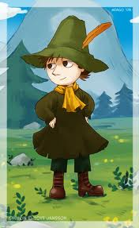
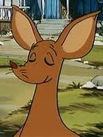
Chapter 1
Moomintroll
Snufkin
Sniff

Slide 17
Moomintroll, Sniff, and Snufkin find a hat.

Slide 18
They take the hat home.

Slide 19
The hat is too big for Moominpappa.

Slide 20
I look better with my smaller hat
Moominpapa

Slide 21
They will use the hat as a wastebasket.

Slide 22
Five small clouds appear.
Snork Maiden

Slide 23
Turn and tell your neighbor what happened in our story

Slide 24
Our goal today was to retell the story using details from the text.
How did you do today?

Slide 25
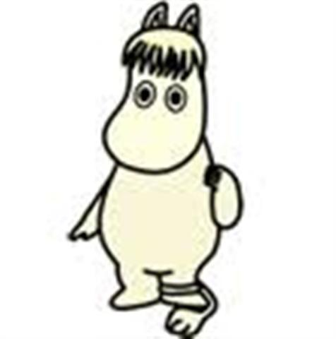
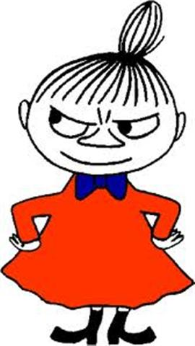
Review yesterday…
Notes:
Click on picture, then roll video to 11:18 min. Continue to about 15.32 minutes.

Slide 26
Our goal today is going to be retelling the story we hear using details from the text.

Slide 27
The Hemulen

Slide 28
Fantastic collector of stamps.
fantastic – unbelievable, out of this world
collector – someone who finds and keeps things

Slide 29
His stamp collection is complete.

Slide 30
Hemulen will collect plants!

Slide 31
He put the plants on the table.

Slide 32
Our goal today was to retell the story we hear using details from the text.

Slide 33
Day 4
Our goal of the lesson is to tell the elements of a fiction story.

Slide 34
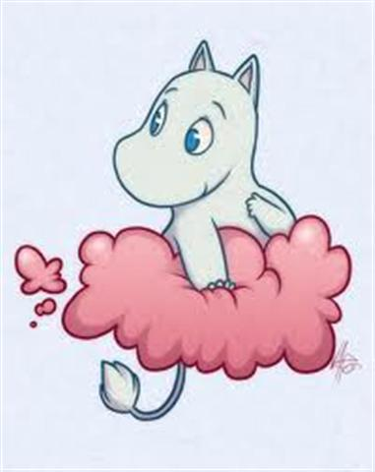
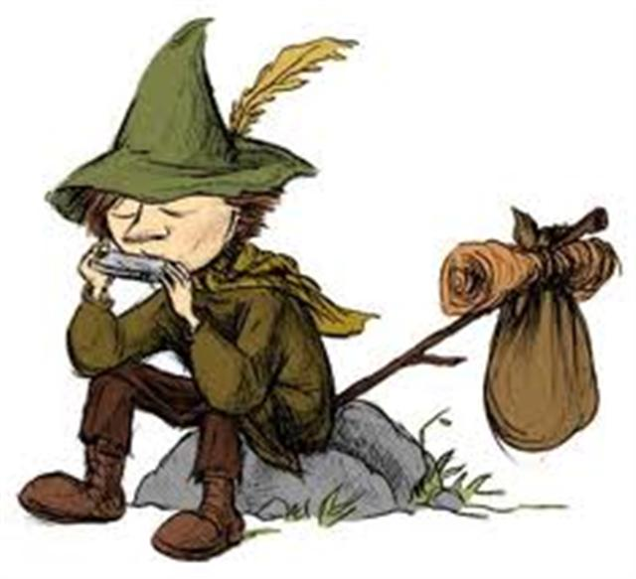
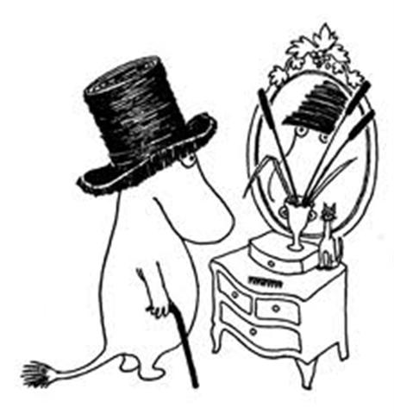
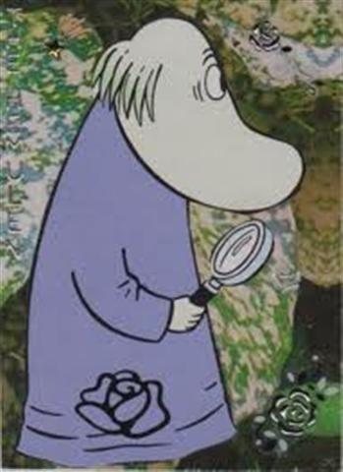
Notes:
APK: Use picture cards to put the story in order.

Slide 35
Day 4
Our goal of the lesson was to tell the elements of a fiction story.

